Slide 1
Microservices Architecture API Gateway, Service Registry and Discovery
Prepared By: Vijay.Koneru & Mohapatro, Bibekananda
June, 1st, 2017

Slide 2
Agenda
Current State Architecture – Specialty
Microservices Representative Eco-System
Elements of Microservices Architecture
API Management
API Gateway Pattern
API Management - Security
API Management - Analytics
Client Side - API Management Logical View
Client Side - API Management Products
Service Side - Service Discovery Products
Service Discovery Pattern
Monitoring & Logging
Circuit Breaker Pattern

Slide 3
Specialty Reference Architecture – Phase 1

Slide 4
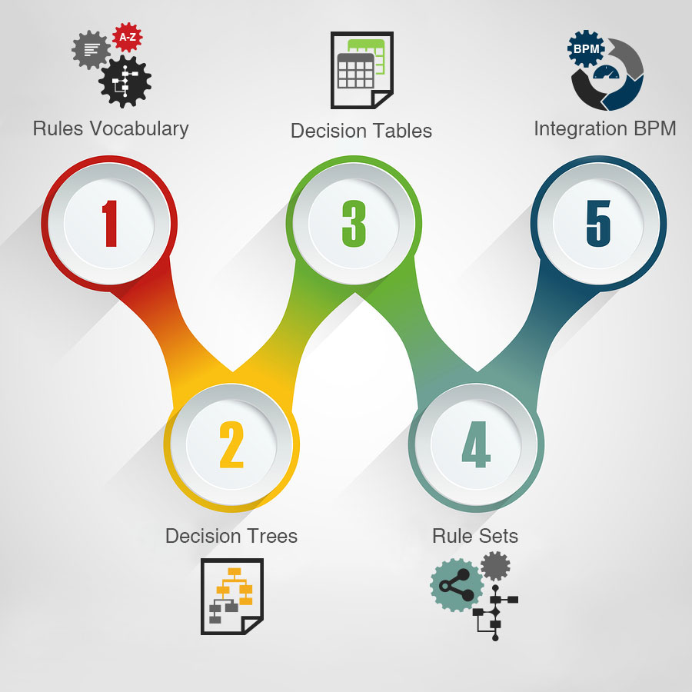
Specialty Reference Architecture
Channels
Services
Enterprise
Systems
Contact
Center
Service Discovery
Service Observability
Service Fault Tolerance
Web App
Package
Legacy
External
Self-Service
Workplace
Process Services
Visibility Services
Patient
Drug
Retail Specialty
Pharmacy
API
GATEWAY
API Management
Billing
Supplies
Mobile
Identify
Management
Provider
Claims
Nurse
Workplace
Optimization Services
Analytics
Information Services
Partner
Workplace
Service Registry
Sparcs
HBS Data
SPRx
Electronic Business
Gateway
Message Queue
Rules Engine
Batch Service
Q1
Message Listener
Q2
Vendor / Partner
Systems

Slide 5
Representative Microservices Ecosystem
Consumer Applications / Portals / Mobil Apps
API Management (Gateway, Analytics, Governance)
Legend
Virtual Machine
VM
Bounded Context Web API
Bounded Context Web API
Bounded Context Web API
Jetty
Application Container - Docker
Jetty
Tomcat
VM
VM
JBOSS
Glassfish
Consul – Service Discovery
Service Discovery - Consul
Log Management – ELK Stack
Jetty
Jetty
Container Management - Mesos
Container Management –
Marathon
Kibana – Service Monitoring
Docker Management

Slide 6
Elements of Microservices Architecture
API Gateway Pattern
Security
Analytics
Service Discovery Pattern
Circuit Breaker Pattern
Monitoring & Logging
Notes:
Anal

Slide 7
API Gateway Pattern
API Gateway - A single point of entry for all client applications to consume backend APIs and services.
Throttling, Security, Caching,
Analytics etc
API Management
Identity Management
Inter Microservice communication
through GW
Analytics
Service Registry
Microservice A
Consumers
Gateway
Microservice B
Microservice C
All service consumers access services
through Gateway
Microservice D

Slide 8
API Management Logical View
API Management Products - Establish a practice for publishing, promoting and overseeing application programming interfaces (APIs) in a secure, scalable environment.
Consumer Applications / Portals / Mobil Apps
Capabilities include:
Creation of end user support resources that define and document the API
Access controls
Plans
Threshold limits
Design guidance
Analytics of usage and availability.
API Management
Data / Process APIs
Mediate
(e.g XML to JSON)
Mashup Responses
Cache Responses
Detect Threats
Authenticate Consumer
Control Traffic
Transform
(e.g. REST to SOAP)
Route
Management Dashboard
Logging, Analytics
Developer Portal

Slide 9
API Gateway - Security
Use the API-gateway style in which there is a single entry point for all client requests.
Client connects to the authorization server and obtains the access token (by reference token). Then send the access token to the API-gateway along with the request.
Token translation at the gateway - API-gateway extracts the access token and sends it to the authorization server to retrieve the JWT (by value-token).
The gateway passes this JWT along with the request to the Microservices layer.
JWTs contains the necessary information to help in storing user sessions, etc. If each service can understand a JSON web token, then you have distributed your identity mechanism that’s allowing you to transport identity throughout your system.
Authorization Server
User Store
JWT
(Claims & Policies)
Rest API
Access Token
Microservice A
Access Token
Rest API
Consumers
Gateway
Microservice B
Rest API
Microservice C
Rest API
Microservice D
JWT processing at each Microservice

Slide 10
Analytics
Analytics capabilities will be used in three ways:
Dashboard: the out of the box dashboard on the management UI is used to monitor traffic patterns and assist with troubleshooting and production support
Custom reports: custom reports can be configured to report on specific KPIs that business users might be interested in. Reports can be generated by setting two parameters, Measures (average tx/s, policy errors, response size, total response time, etc…) and Drilldowns (API product, Client ID, Developer APP, Custom, etc…).
Data Export: data can be exported out of the API management platform in two ways
Static Data Export:
APIs can used to extract analytics data from API Management
Example extracts: App Count per developer, requests per developer, average total response times, etc…
Real-time integration with 3rd party tool (i.e. ELK Stack)
The Policies within API Management lets you send syslog messages to third-party log management services
ELK stack can listen on a TCP or UDP port for data coming from the syslog service on one or more machines
API
Analytics
Dashboard
Custom Reports
Data Export

Slide 11
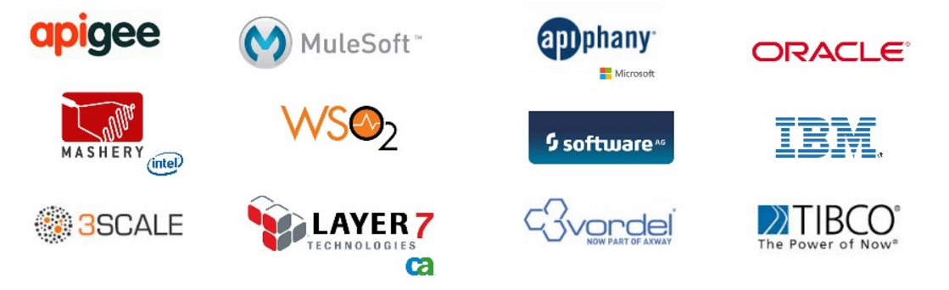
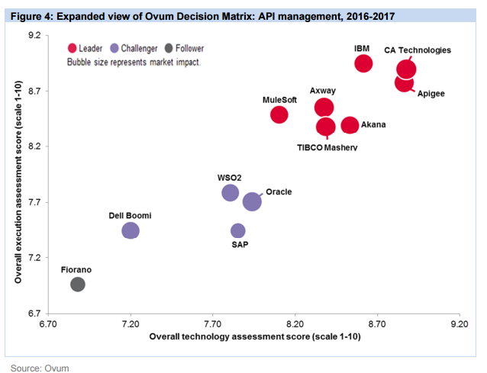
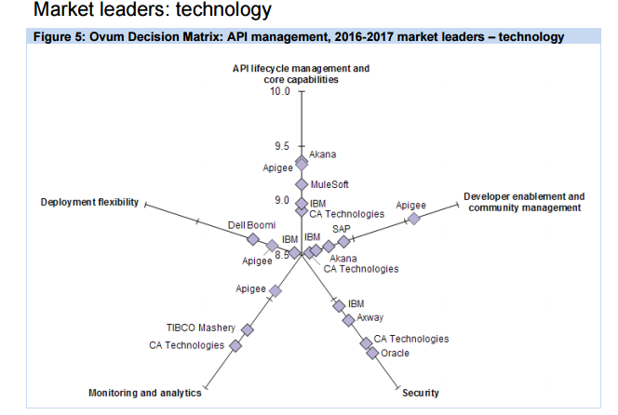
API Management Products
Apigee, CA Technologies, MuleSoft, IBM and Akana are top five vendors in API lifecycle management and core capabilities.

Slide 12
Apigee Commercial
Company | apigee
Employees | 201-500
Headquarters | Santa Clara, California
Website | apigee.com
Founded | 2004
Presence | Public company and Acquired by Google
OVERVIEW
Apigee has a mature and well-rounded API management offering strengthened by an aggressive product strategy which offers a combination of a unified API platform (API Edge) and big data predictive analytics (Apigee Insights) along with technical and business infrastructure and tactical requirements of enterprise API initiatives.
STRENGTHS
Products | Details
Apigee Edge | API management user interface
Apigee Insight | Analytics
Apigee API Exchange | Telecom Specific functionality
Apigee Sense | Cloud-based bot detection and protection.
Apigee Edge Micro gateway | Available on-premises and in the cloud, and helps to simplify deployment of the Apigee solution
As a product it has shown the abilities in API management prospects, and provides a platform from which its customers can target their own APIs to the appropriate constituencies of developers and spread their success stories.
A recent partnership with Pivotal brings Apigee's API management to bear on applications built on Pivotal Cloud Foundry, which leverages platform as a service (PaaS) capabilities such as horizontal scaling and event processing.
CHALLENGES
The investment proposition for Apigee’s API management offering that is suitable for medium to broad-level enterprise initiatives is relatively high in comparison to some of its competitors
No single dashboard view as desired by enterprise clients.

Slide 13
MuleSoft Commercial
Company | Mulesoft
Employees | 500+
Headquarters | San Francisco, CA
Website | mulesoft.com
Founded | 2003
Presence | Privately Held
OVERVIEW
MuleSoft is a vendor whose product has grown out of the open source community. Mule ESB is MuleSoft’s core solution and allows the company to specialize in integration technology focused on supporting business connectivity.
Products | Details
Anypoint Studio | IDE to design and build integrations
Anypoint Connectors | Connect any endpoints using out-of-the-box connectors
Anypoint Exchange | Access and leverage a rich collection of integration components
Anypoint API Designer | A graphical syntax-aware platform to design APIs using RESTful API
Anypoint API Portal | A platform to engage with API developers and drive adoption
Mule runtime engine | Hybrid engine that powers all of our integration flows.
Anypoint API Manager | Expose and provision your APIs
Anypoint API Analytics | Real-time view of API consumption trends and operational performance
STRENGTHS
As a product that has grown out of the open source community, it contains crowdsourced innovations that set it apart from the competition.
Mule Anypoint ESB and API platforms includes comprehensive monitoring and administrative capabilities.
Mulesoft provides technical start to an API program (but not the business start, because the MuleSoft Catalyst offering is still evolving).
CHALLENGES
The solution’s messaging capabilities rely on JMS technology. ActiveMQ which is a different Open Source Product.
This community version of MuleSoft is not more available. MuleSoft is considered as a Commercial product family.

Slide 14
WSO2 Open Source
Company | WSO2
Employees | 450+
Headquarters | Mountain View, CA
Website | wso2.com
Founded | 2005
Presence | Privately Held
OVERVIEW
WSO2 is a cloud native and open source vendor who specializes in middleware technology. Enterprise Service Bus is a standards-based ESB solution built on top of WSO2’s Carbon technology.
STRENGTHS
As an open source solution, WSO2 provides a cost-effective option that is capable of scalability and agile deployment.
Enterprise Service Bus is built on WSO2’s Carbon technology, leveraging its core features (clustering, caching, etc.) to improve the architecture and functional capabilities of the bus.
Users cite the openness of the solution as a strong selling point that enables scalability and flexibility in their business environment.
Products | Details
API Gateway | Design, compose and publish APIs
Enterprise Integrator | Service bus to mediates and transforms data between legacy systems, SaaS applications, services, and APIs
Identity Server | Identity management
Real-time Analytics | Analytics product that analyzes data streams in real time
IoT Server | Manage devices, Apps with enterprise mobility management (EMM/MDM) solution
CHALLENGES
WSO2’s reliance on additional open source components for features, such as message persistence, publishing, and subscription, adds additional configuration steps to the initial setup.
WSO2 users may still have to rely more heavily on service support contracts and the open source community to develop their integration solutions.

Slide 15
TYK Open Source
Company | Tyk Technologies
Employees | 11-50
Headquarters | LONDON, UK
Website | tyk.io
Founded | 2014
Presence | Privately Held
OVERVIEW
Tyk is an open source API management platform, featuring an API gateway, analytics, developer portal and dashboard, all with speed and scalability in mind..
STRENGTHS
Manage Multiple APIs: Tyk’s dashboard has one gateway to manage all your APIs with streamlined integration
Customisable API Portal: Tyk’s portal makes it easy to publish your APIs to the world and allow developers to enroll for access.
Cloud, Hybrid or On-Premise Integrations:Tyk offers fully supported infrastructure through the cloud for free
Products | Details
API Management | Design, compose and publish APIs
API Portal | API Lifecycle Management
API Gateway | Identity management
CHALLENGES

Slide 16
Service Registration Patterns
Self Registration - A service instance is responsible for registering itself with the service registry.
Service A
When going up / down
Service
Registry
Service B
When going up / down
Third Party Registration - A 3rd party registrar is responsible for registering and unregistering a service instance with the service registry.
Service A
Start Service
Service
Registry
Service B
Stop Service
Service Manager
Service C
Detects Service Crash

Slide 17
Service Discovery Patterns
To find the available Microservices and their location, we need to have a service discovery mechanism
Client-Side Discovery - Client is responsible for determining the network locations of available service instances and load balancing requests across them.
API Gateway or Client
Client
Rest API
Microservice A
Rest API
Discover
Service
Service
Location
Microservice B
Rest API
Publish
Microservice C
Rest API
Service Registry
Microservice D
Server-Side Discovery - The client makes a request to a service via a load balancer. The load balancer queries the service registry and routes each request to an available service instance
API Gateway or Client
Load Balancer
Client
Rest API
Microservice A
Rest API
Discover
Service
Service
Location
Microservice B
Rest API
Publish
Microservice C
Rest API
Service Registry
Microservice D

Slide 18
Service Discovery – Product
Consul - Hashicorp
Kubernetes- Google
Distributed key, value(KV) store based on data directories
Provides comprehensive service health checking using both in-built solutions as well as user provided custom solutions.
Provides REST based HTTP API for interaction.
Security: TLS and ACLs
Service database can be queried using DNS.
Does dynamic load balancing.
Integrates well with Docker.
Supports single data center and can be scaled to support multiple data centers.
For internal service discovery, Kubernetes provides two options:
Environment variable
DNS
For external service discovery, Kubernetes provides two options:
NodePort
Load balancer
Kubelet can implement a health check to check if Container is healthy.
Kubelet will kill the Container if it is not healthy. Replication controller would take care of maintaining endpoint count.
Health check is defined in Pod manifest.

Slide 19
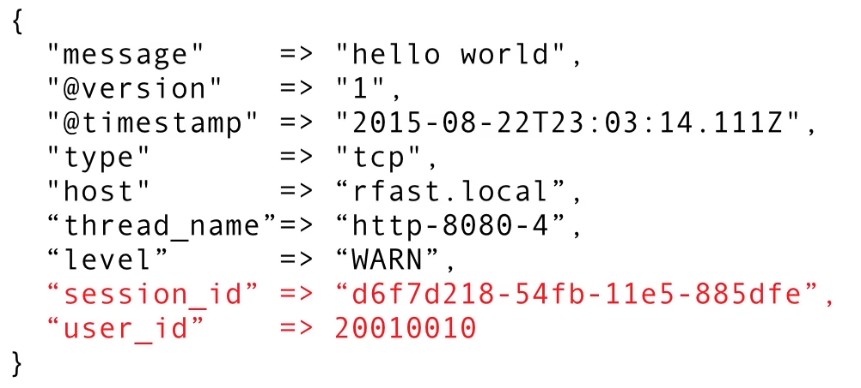
Service Observability
Extremely important in Distributed Architecture
Fine grained visibility is required
Lots of technologies to choose from
Visualization is important
Automated alerting and alarms also important
Request Latency
JVM & OS Metrics
Heap/memory usage
Garbage Collection Metrics
Database query timings
Service Call timings
Information to Monitor

Slide 20
Service Observability - Products
Monitoring
Graphite
OpenTSDB
InfluxDB
Prometheus
SpringBoot
Logging
Hosted
Logentries
Loggly
Home grown
Send logs to Database or Hadoop
On Prem
Splunk
ELK Stack
Recommended : Prometheus
Recommended : ELK Stack

Slide 21
Circuit Breaker pattern
API gateway implement circuit breakers, which means that after a specific threshold, the API gateway will stop sending data to the component that’s failing. Circuit breakers simply close the circuit so no more requests are allowed to go to that component
LB
Service A
DB Schema
Client
API
Gateway
LB
Service B
DB Schema
LB
Service C
DB Schema

Slide 22
Thank You!

